Slide 1


INTRODUCING A NEW PREVENTIVE SERVICE
Bringing the Diabetes Prevention Program to Anthem Members

Slide 2

Today’s
conversation
Why focus on diabetes prevention?
The Diabetes Prevention Program
Introducing Solera Health
Member referrals
Page 2

Slide 3

Anthem is implementing a new covered preventive service – the Diabetes Prevention Program (DPP).
The DPP will be available at no cost to all Anthem members who qualify.
Page 3

Slide 4
WHY FOCUS ON DIABETES PREVENTION?
86M
1 in 3 of us is at risk
for diabetes.
More than 86 million Americans today have prediabetes, and most
of us don’t know it.
Prediabetes means that blood sugar levels are higher than normal, but not high enough yet to
be classified as type
2 diabetes.
Page 4

Slide 5
WHY FOCUS ON DIABETES PREVENTION?
WHO IS AT RISK?
Members who have the following factors are at higher risk for prediabetes.
Weight:
body mass index
(BMI) over 25
Age:
over 40
years old
Family history:
parent or sibling
with diabetes
Ethnicity:
Hispanic or
African American
Activity level:
More sedentary
lifestyle
Page 5

Slide 6

WHY FOCUS ON DIABETES PREVENTION?
THERE’S GOOD NEWS FOR THOSE AT RISK.
In 2001, the National Institutes of Health (NIH) and the Centers for Disease Control and Prevention (CDC) proved that losing a modest amount of weight significantly reduced a person’s risk for developing diabetes.
Losing just 5 to 7% of body weight via dietary changes and increased physical activity resulted in a 58% risk reduction.
Page 6

Slide 7

THE DIABETES PREVENTION PROGRAM
INTRODUCING THE DIABETES PREVENTION PROGRAM (DPP)
The DPP is a 12 month program designed to help participants adopt healthier lifestyle habits and lose a modest amount of weight.
The program focuses on healthier eating, increased physical activity, and managing the challenges that are associated with lifestyle change.
After the initial 16 weeks, participants attend monthly sessions to reinforce the new lifestyle habits they’ve adopted.
Page 7

Slide 8
THE DIABETES PREVENTION PROGRAM
DIABETES PREVENTION PROGRAM (DPP) ELEMENTS
Personal health coach
Weekly lessons
There are an array of organizations that offer Diabetes Prevention Programs (DPPs). While formats vary–for instance, some meet in person while others are conducted online–most share a core set of elements.
Small group for support
Tools like wireless scales
and/or activity trackers
Page 8

Slide 9
THE DIABETES PREVENTION PROGRAM
The DPP Difference
WHAT DPP IS
WHAT DPP ISN’T
Solution for those with prediabetes/metabolic syndrome
Disease management program for those with diabetes
Preventive service-e.g. flu shot, mammogram
Wellness program that requires a buy up
Evidence-based program developed by the CDC
Lifestyle coaching program
12 month program with 16-week sessions followed by eight monthly sessions
Short term program like a challenge
Targeted at populations based on CDC-established risk factors
Targeted at an employer-determined population
Conducted by CDC-recognized providers
Conducted exclusively by doctors and nurses
Page 9

Slide 10
THE DIABETES PREVENTION PROGRAM
DPP historical financial results (non Anthem)
Historical Financial Reports
Florida BCBS short term ROI based on a 20% reduction in pmpm costs for DPP participants
Avg health plan cost for a diabetic member is $11,700/year compared to $4400 for a no-diabetic plan member
CMS when adding DPP as a benefit cited a savings of $2650 if a participant attended 4 sessions
Page 10

Slide 12

MEET SOLERA HEALTH
Anthem is partnering with Solera Health to bring the DPP to its members.
Solera enrolls members who are at risk, matches them with a DPP partner, submits milestone-based claims on behalf of its DPP partners, and reports on outcomes.
Page 12

Slide 13
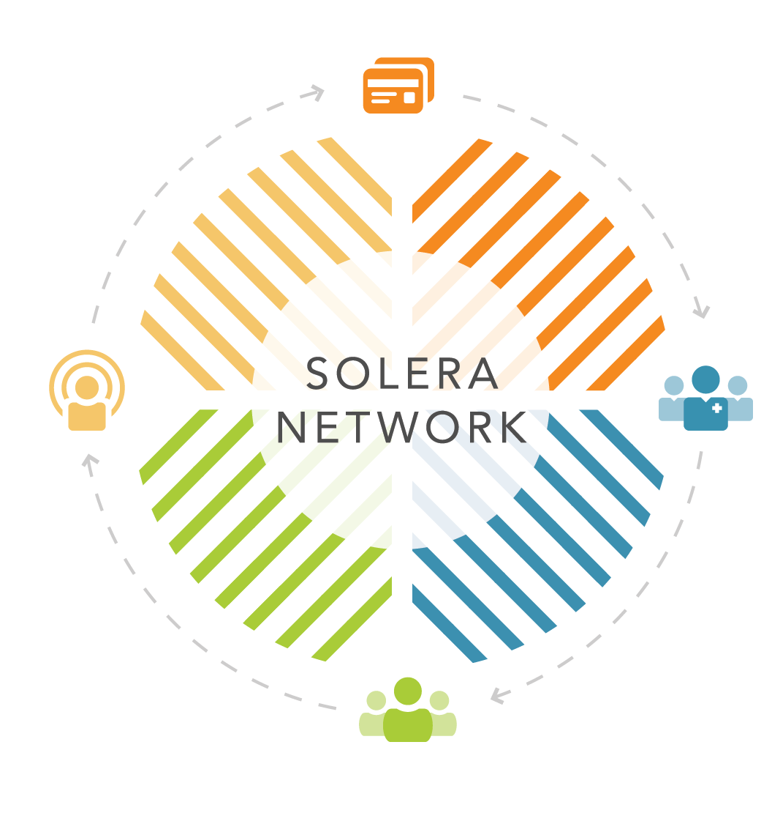
INTRODUCING SOLERA
How it works
1. ANTHEM
Identifies qualified members via care gap analysis and covers the Diabetes Prevention Program as an ACA-covered preventive medical benefit.
2. BDTC PRACTICES
Use EMR data to identify and refer patients to Solera for enrollment in a Diabetes Prevention Program.
3. QUALIFIED MEMBERS
Choose from a variety of qualified local, digital, and community DPP providers to find the best match for success.
4. COMMUNITY/DIGITAL DPP PROVIDERS
Provide a variety of options for the Diabetes Prevention Program (DPP), driving consumer choice and member engagement.
Page 13

Slide 14
INTRODUCING SOLERA
DIABetes prevention stakeholder roles
DPP IMPLEMENTATION TASK LIST | HEALTH PLAN | EPHC Providers | SOLERA | DPP PARTNER | EMPLOYERS **
Provide program eligible information
Communicate benefit availability to employers/doctors/employees |  |  |  |  | **
Consumer engagement and enrollment: telephone and website
Identify members/patients with Prediabetes and refer
Provide DPP to members & track data for milestones
Submit claim to health plan
Process and pay claim
Pay DPP partner for milestone-based activity
Provide ongoing customer service for DPP members
Provide data/reporting to stakeholders
Implement employer specific DPP engagement plan |  |  |  |  | **
Mobile Health Consumer identification (risk screen)
Identify Prediabetes members as a care gap (RHI)
HEALTH
PLAN
SOLERA
HEALTH
DELIVERY
PARTNER
PRODUCT DESIGN TASK LIST
**
Employers can engage in DPP promotion or defer implementation to plan and providers.
Page 14
**

Slide 15

INTRODUCING SOLERA
NETWORK of DPP partners
Smartphone
&/or Online
Smartphone
Online
Text Message
Phone
Face to face
Page 15

Slide 16
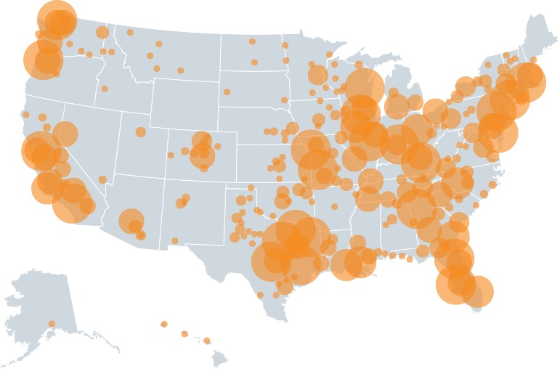
INTRODUCING SOLERA
FACE TO FACE NETWORK
1688 in network locations, 1000’s of meeting times
486 network locations
800+ community network locations*, various meeting times
* Contracting occurs as needed
Page 16

Slide 17
MEMBER REFERRALS
HOW do MEMBERS qualify for THE DPP?
Members qualify in one of the following ways:
1
2
3
Provider referral:
A clinician refers a member to the DPP program
Care gap analysis:
A member is identified
via an RHI “Care Gaps” analysis
Self-referral:
A member visits solera4me.com and takes a 1-minute quiz
to qualify for the DPP
Page 17

Slide 18

MEMBER REFERRALS
HOW will MEMBERS find out about THE DPP?
Provider campaigns
Employer-based outreach
Page18

Slide 19
MEMBER REFERRALS
Turnkey communications
Anthem Communication Toolkit (can be co branded for employer or provider)
Internal Communications
Newsletter Articles
Training PowerPoint
Clinical PowerPoint
Anthem Customer Support
FAQ
Customer Service Call Script
Follow Up Email Template
One Page Flyer
Provider Communications
Provider Email Campaign
Provider Letter
Patient Brochure
Employer Communications
Introductory Email
Biometric integration
Mobile Health Consumer Content
Newsletter Articles
Employer Presentation
Lunch and Learn presentation
Page 19

Slide 20
Questions?

